Slide 1
A Commercial Case Study: Colorado Mesa University
Matt Garlick CEM, BEMP, CCP
CEO
The GreyEdge Group
Notes:
How to update the logo in the Workshop PowerPoint Template:
You will need to place your logo into the PowerPoint template in 2 places. Please refer to the following instructions for guidance on how to place your logo:
- Open the PPT template in a new widescreen (16:9) presentation.
- Click “View” on the top toolbar.
- Click “Slide Master.”
- Edit the top content slide and delete the “Insert Your Logo” textbox.
- Place your logo (JPG or PNG) into the content slide in its place. Resize accordingly.
- Edit the second, title slide and delete the “Insert Your Logo” textbox.
- Place your logo (JPG or PNG) into the title slide in its place. Resize accordingly.
- Click “Close Master View”.

Slide 2
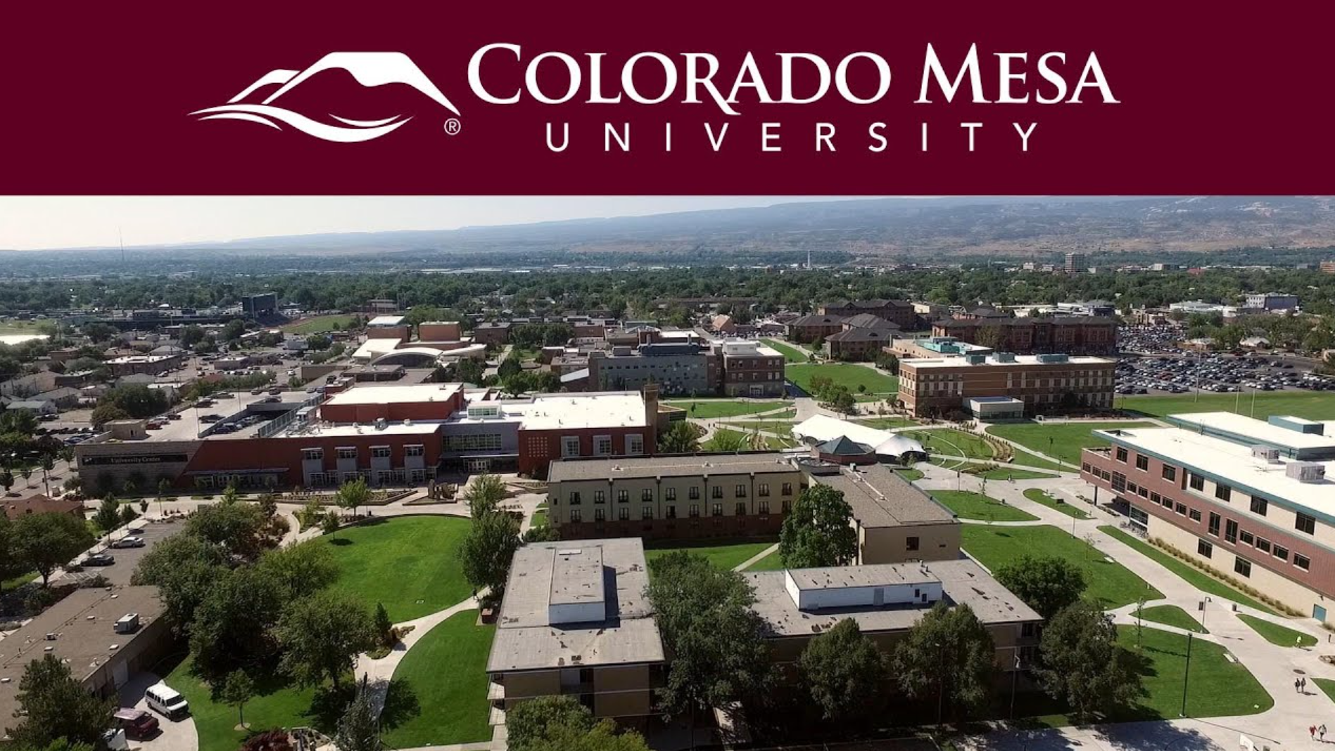
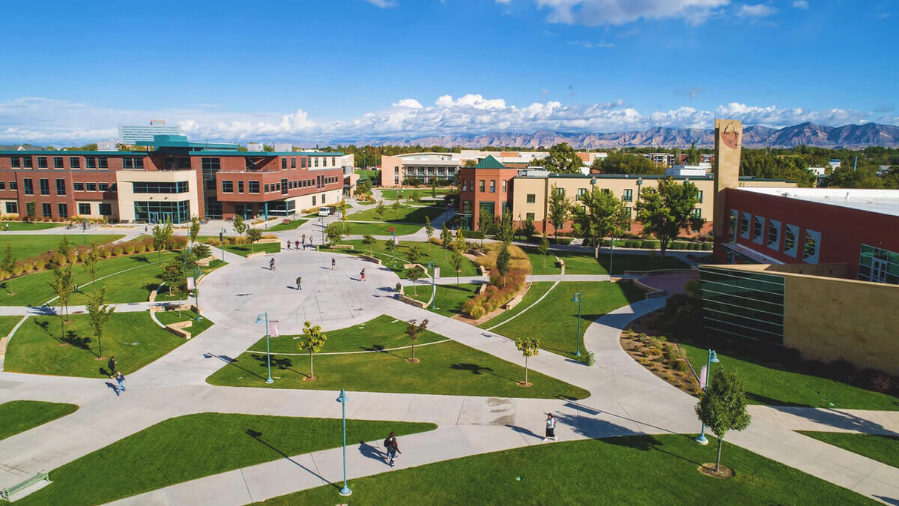
Colorado Mesa University
Grand Junction, CO
11,000 Students
141 Acres
37 Buildings
Climate Zone 5B

Slide 3
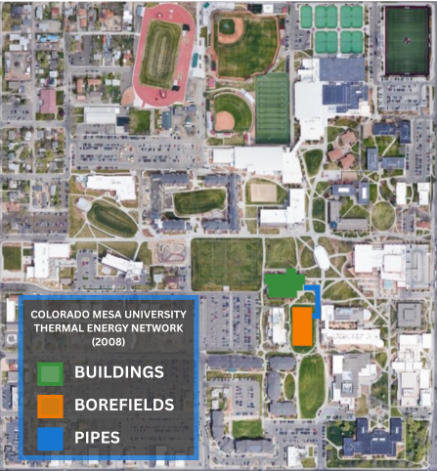
Evolution 2008
Dominguez Hall

Slide 4
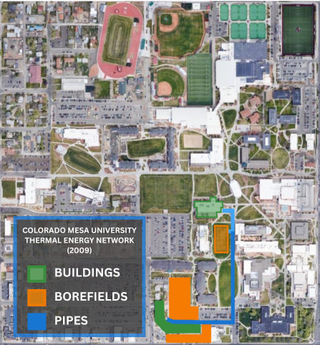
Evolution 2009

Slide 5
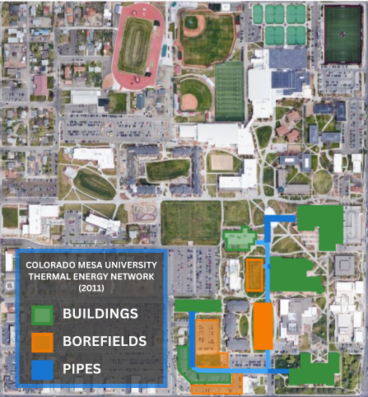
Evolution 2011

Slide 6
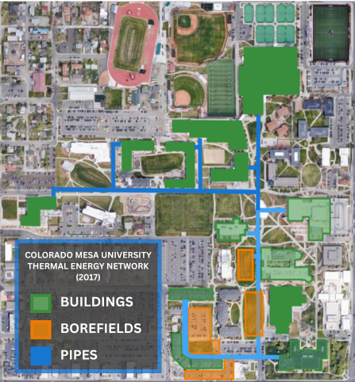
Evolution 2017

Slide 7
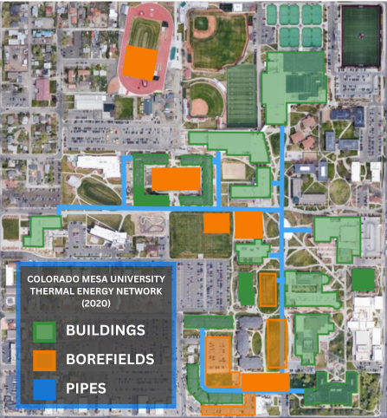
Evolution 2020

Slide 8
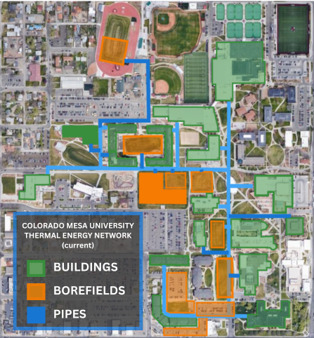
Evolution Current
79% of campus connected (20 bldgs, 1.5MSF)
3,500 Ton Capacity
Five independent Microdistricts
Expansion on track to double area served by 2030

Slide 9
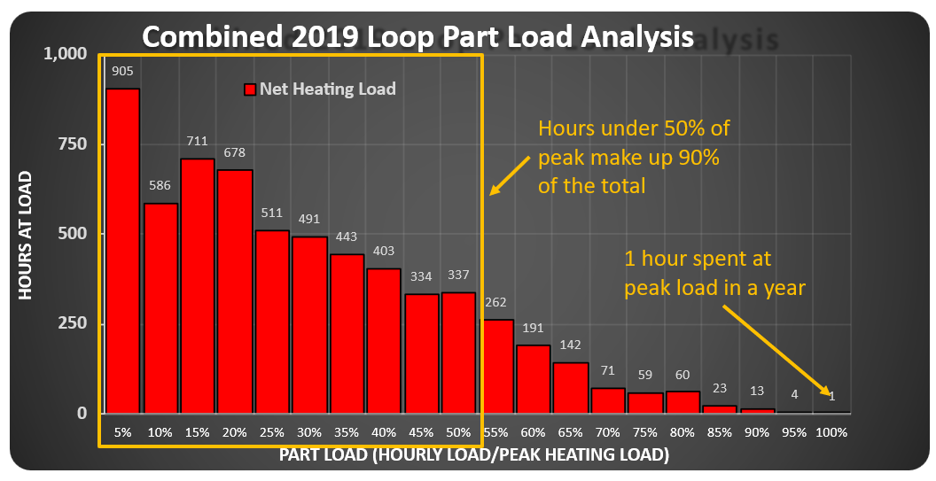
CMU is a Hybrid System
The 50/90 Rule
Thermal Resouces:
Load Diversity!
Boilers
Cooling Towers
Irrigation Hx
Geoexchange

Slide 10
CMU is a Hybrid System
The 50/90 Rule
Thermal Resources:
Load Diversity!
Boilers
Cooling Towers
Irrigation Hx
Geoexchange
Boilers have turned on ONCE in 10 years!

Slide 11
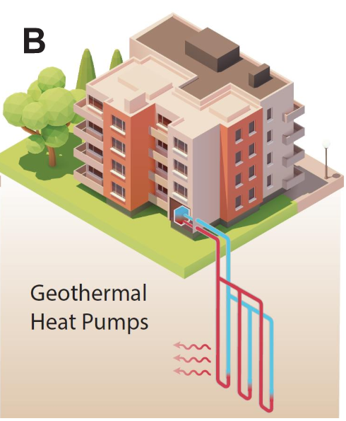
Multi-Source Optimization
Standard Geo System- 217 feet per ton
CMU ATL- 84 feet per ton
Image Credit: NLR

Slide 12
Multi-Source Optimization
Standard Geo System- 217 feet per ton
CMU ATL- 84 feet per ton
A 62% CapEx Reduction!
Image Credit: NLR

Slide 13
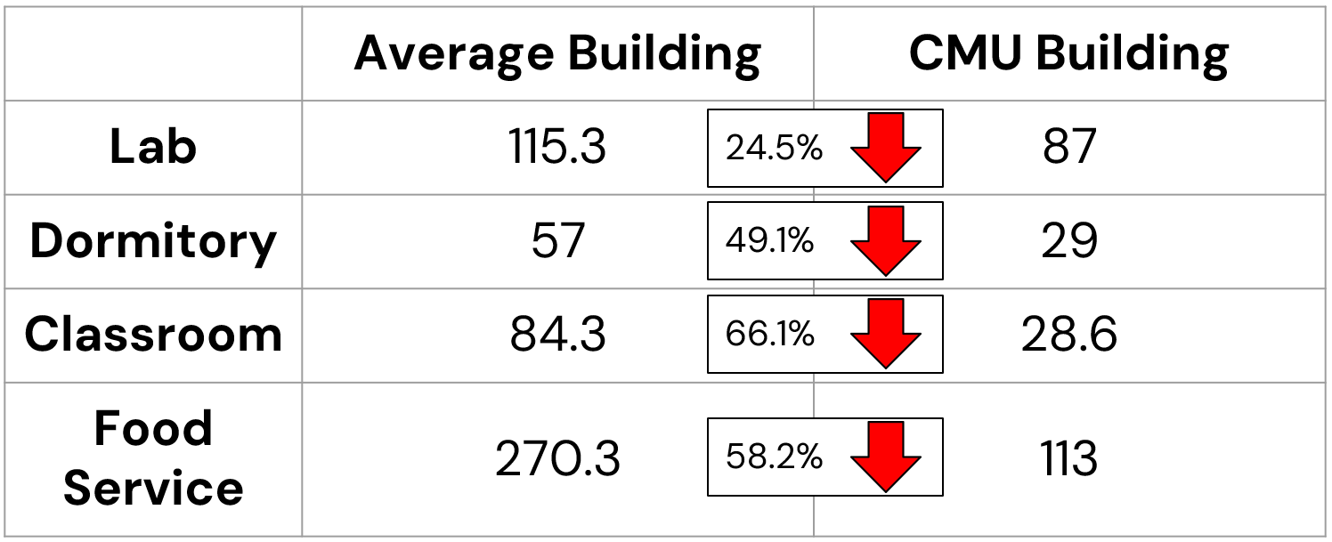
Building Energy Use Intensity (kBTU/sf/yr)

Slide 14
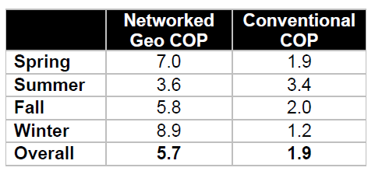
Overall System Efficiency
Source: Xcel Energy’s “Evaluating a Community Ground Source Heat Pump System at CMU”

Slide 15
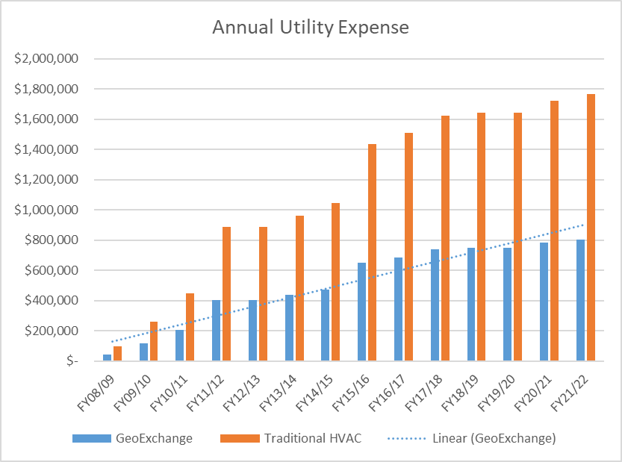
Utility Savings
Annual energy savings: $1,568,032
Cumulative energy savings (since 2008):
$16 million +

Slide 16
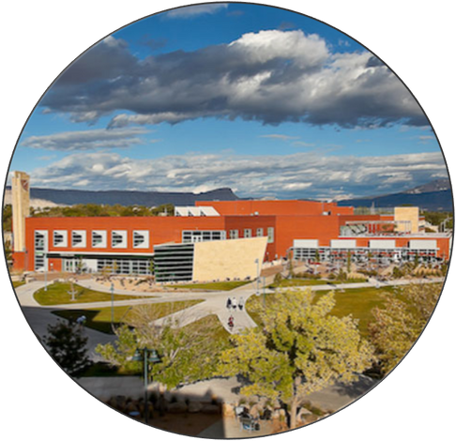
Utility Savings
Compared to a conventional cooling and heating system, this system has:
Demand reduction of ~650 kW
Energy savings of ~1.3 GWh
Natural gas savings of ~58,000 Dth
Water savings of ~10 million gallons

Slide 17
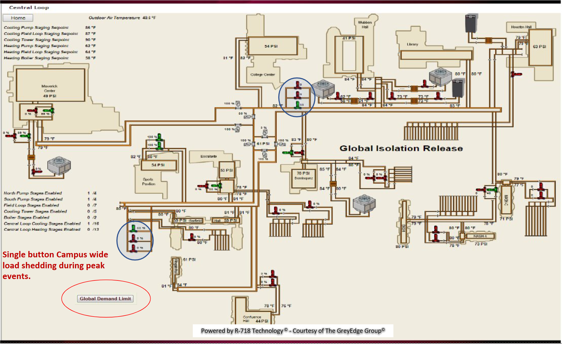
Peak Shifting

Slide 18
Demand Limiting

Slide 19
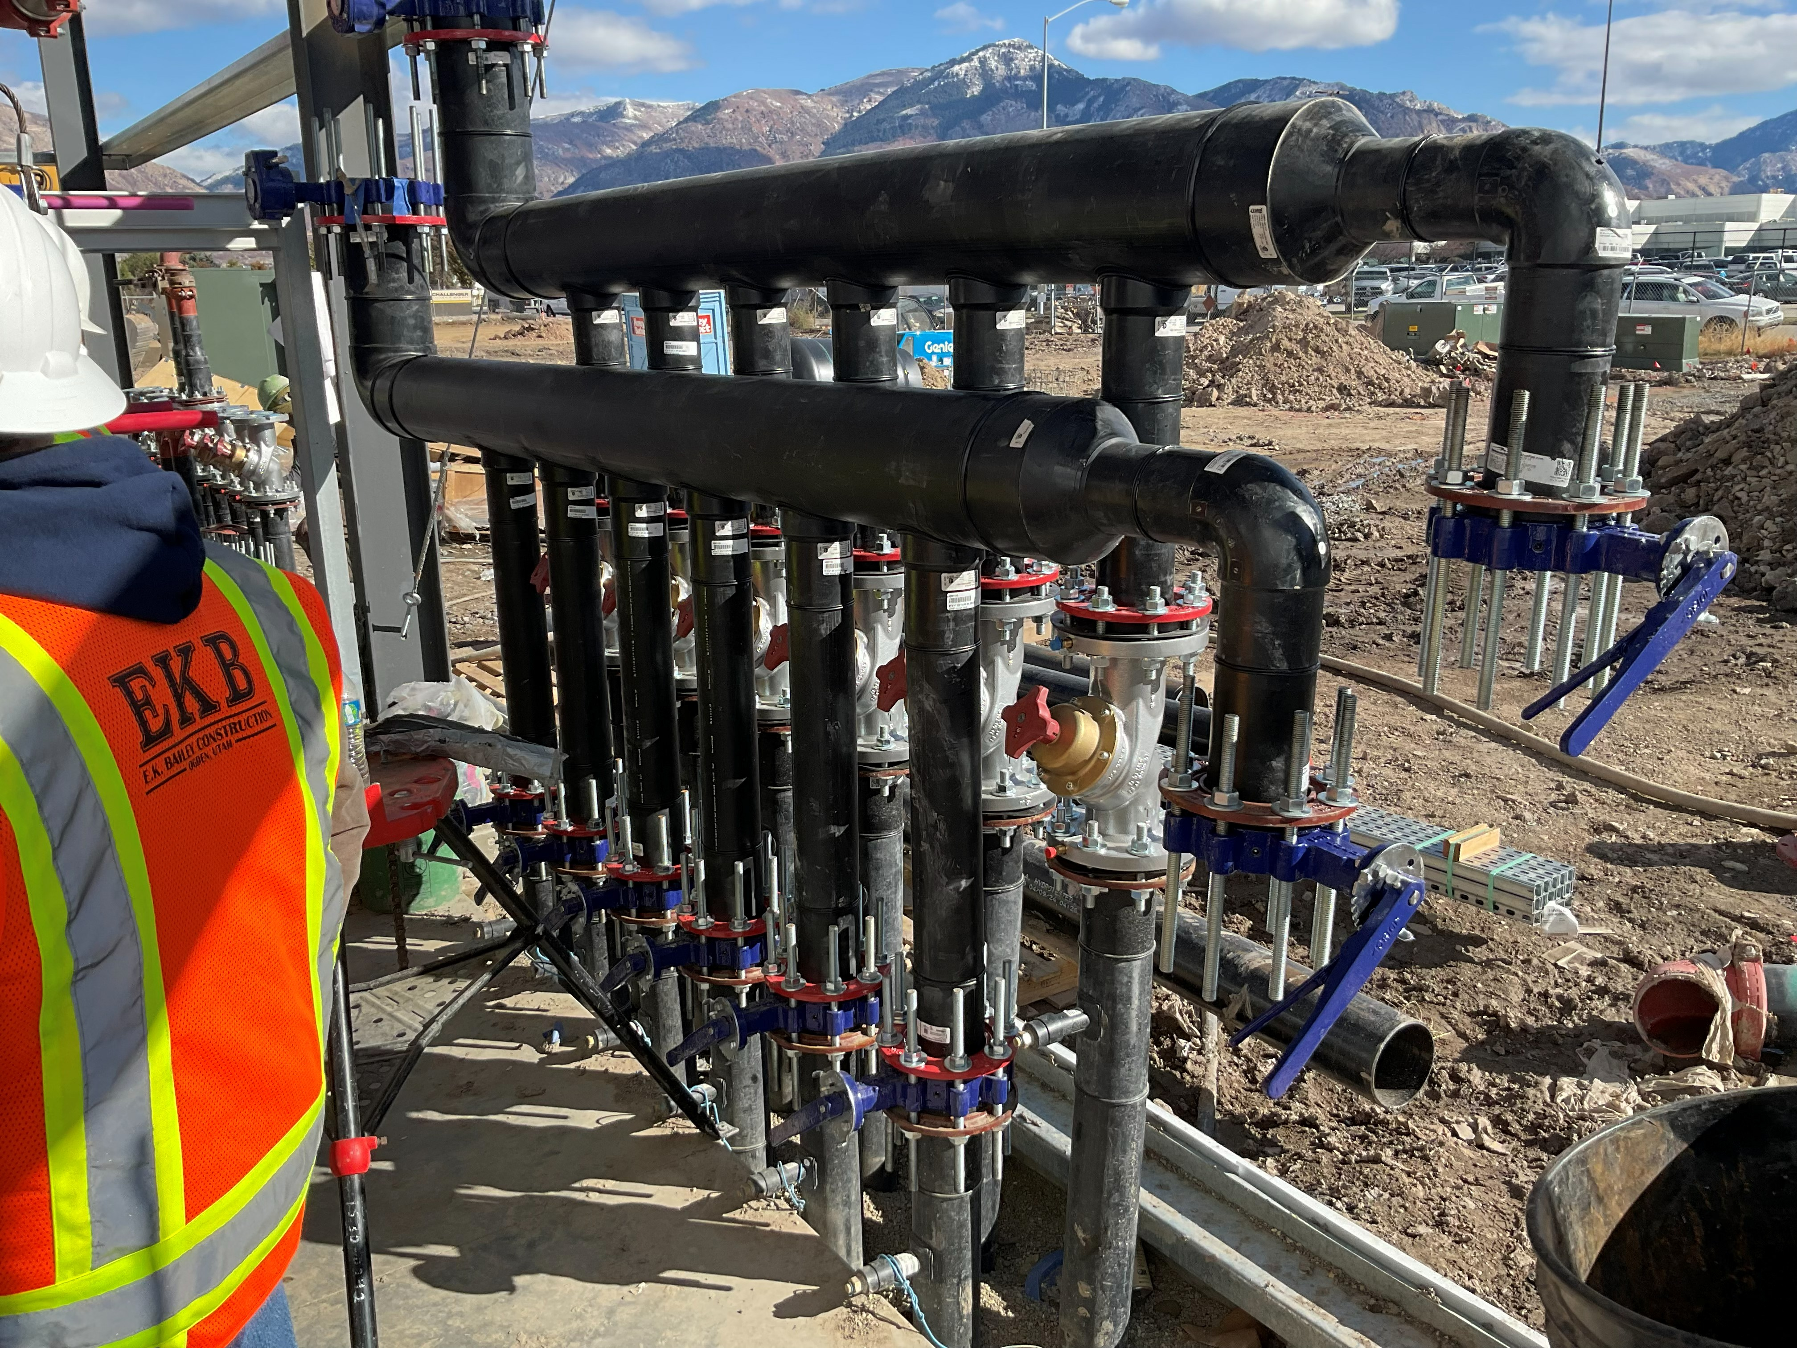
Reduced Soft Costs
Reduced Electrical Service Upgrades
800,000sf Campus 2008-
3 HVAC Technicians
2,200,000sf Campus 2026-
4 HVAC Technicians
Driver Buildings can limit performance

Slide 20
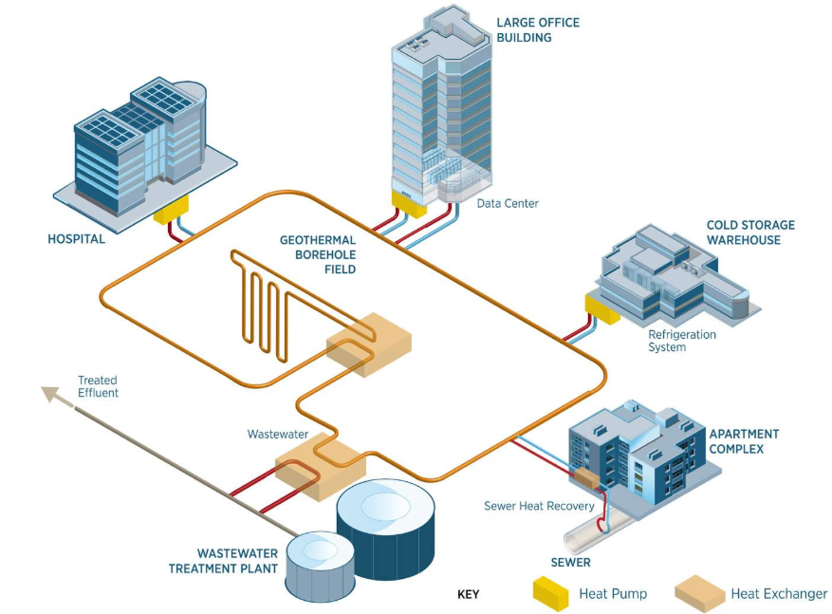
Questions
Matt Garlick CEM, CCP, BEMP
CEO
The GreyEdge Group
mgarlick@greyedgegroup.com
Image Credit: NLR

